Slide 1

Guess the

Slide 2
What film (or book) are these laws from?
A robot may not injure a human being or, through inaction, allow a human being to come to harm.
A robot must obey the orders given it by human beings, except where such orders would conflict with the First Law.
A robot must protect its own existence as long as such protection does not conflict with the First or Second Laws.

Slide 3
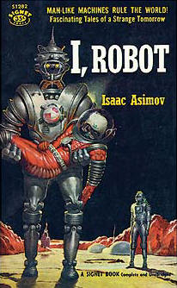
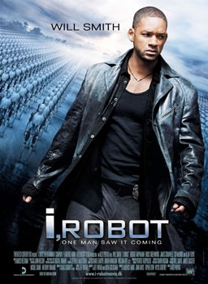
I, Robot

Slide 4
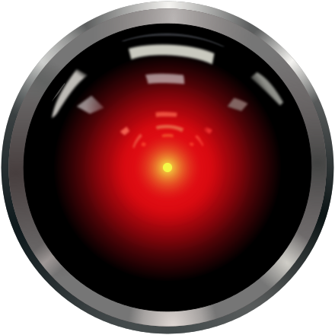

Slide 5
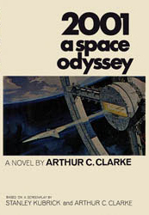
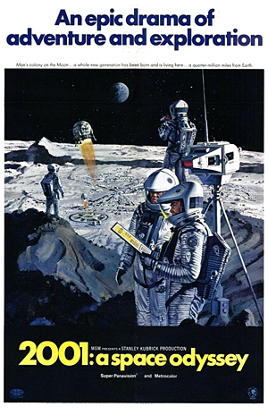

Slide 6
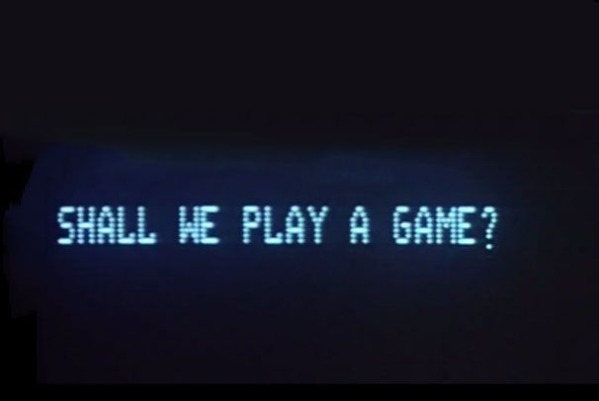

Slide 7
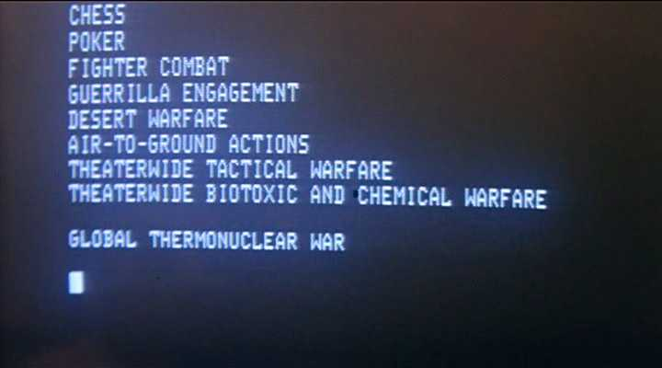

Slide 8
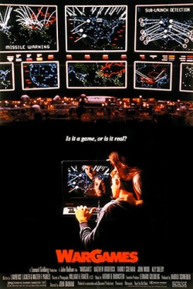

Slide 9
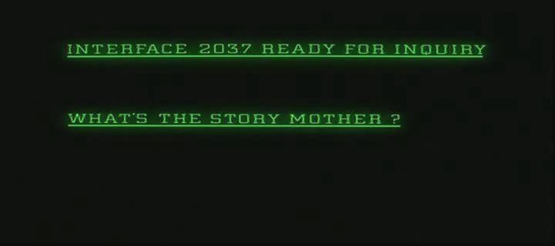

Slide 10
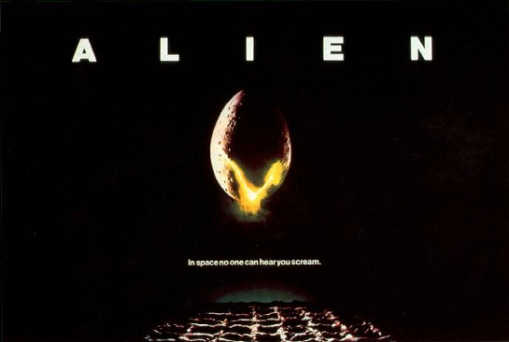

Slide 11
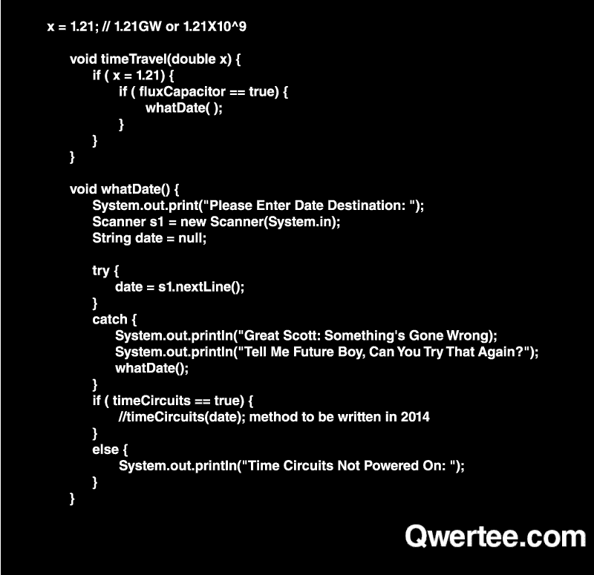

Slide 12
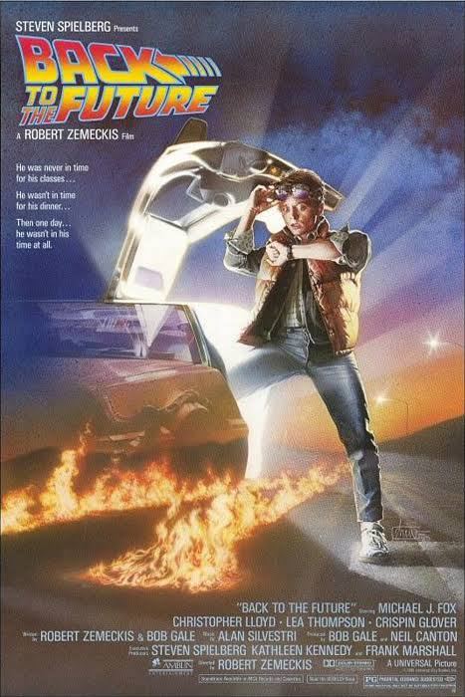

Slide 13
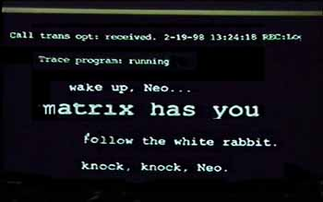

Slide 14
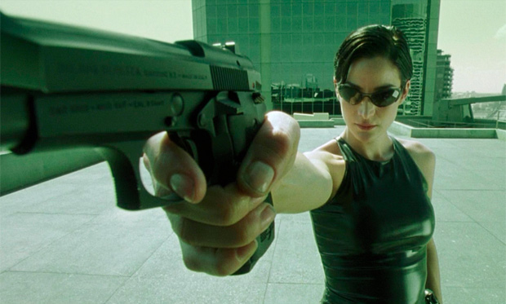

Slide 15
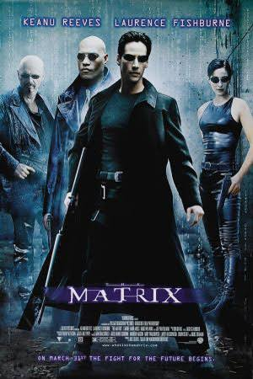

Slide 16
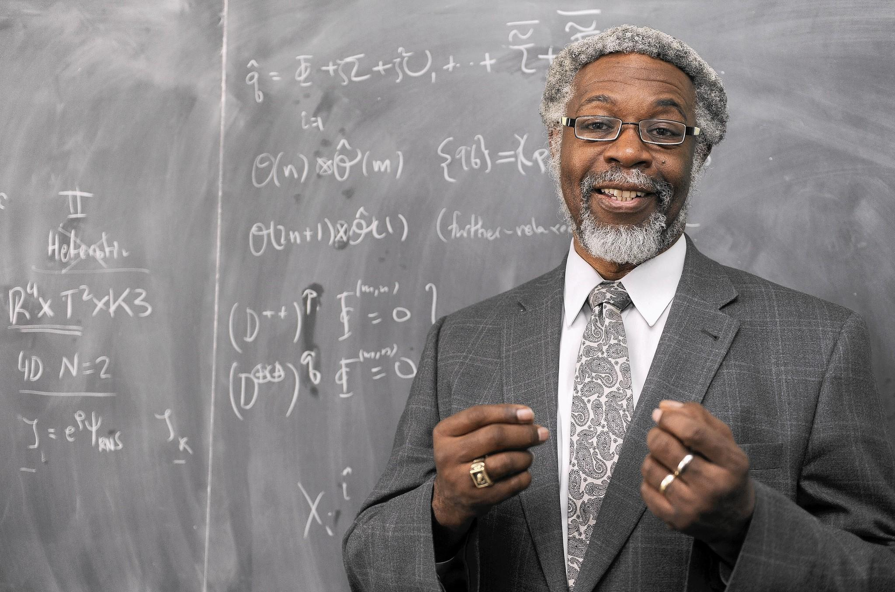

Slide 17
Sylvester James Gates, Jr. (born December 15, 1950), known as S. James Gates, Jr, or Jim Gates, is an American theoretical physicist, known for work on supersymmetry, supergravity, and superstring theory. He is currently a Professor of Physics at the University of Maryland, College Park, a University of Maryland Regents Professor and serves on President Barack Obama's Council of Advisors on Science and Technology.

Slide 18
https://youtu.be/9Z9tO0D6W-Y?t=4m23s

